Slide 1
Designing Accurate
Data Entry Procedures
15
Kendall & Kendall
Systems Analysis and Design, 9e
Kendall & Kendall Copyright © 2014 Pearson Education, Inc. Publishing as Prentice Hall

Slide 2
Learning Objectives
Understand the uses of effective coding to support users in accomplishing their tasks.
Design effective and efficient data capture approaches for people and systems.
Recognize how to ensure data quality through validation.
Articulate accuracy advantages of user input on ecommerce websites.
Kendall & Kendall Copyright © 2014 Pearson Education, Inc. Publishing as Prentice Hall

Slide 3
Accurate Data-Entry Objectives
Effective coding
Efficient data capture
Effective data capture
Assuring data quality through validation
Kendall & Kendall Copyright © 2014 Pearson Education, Inc. Publishing as Prentice Hall
Notes:
The quality of data input determines the quality of information output.
Effective coding—creating meaningful coding for data.
Efficient data capture—designing efficient data capture approaches.
Effective data capture—assuring complete and effective data capture.

Slide 4
Major Topics
Effective coding
Types of codes
Guidelines for coding
Validation methods
Check digits
Ecommerce accuracy
Kendall & Kendall Copyright © 2014 Pearson Education, Inc. Publishing as Prentice Hall

Slide 5
Effective Coding
Data that are coded require less time to enter
Coding helps to reduce the number of items entered
Coding can help in sorting of data during the data transformation process
Coded data can save valuable memory and storage space
Kendall & Kendall Copyright © 2014 Pearson Education, Inc. Publishing as Prentice Hall
Notes:
Coding—the process of putting ambiguous or cumbersome data into short, easily entered digits or letters.

Slide 6
Human Purposes for Coding
Keeps track of something
Classifies information
Conceals information
Reveals information
Requests appropriate action
Kendall & Kendall Copyright © 2014 Pearson Education, Inc. Publishing as Prentice Hall
Notes:
Specific types of codes allow us to treat data in a particular manner.

Slide 7
Keeping Track of Something
Simple sequence code
Alphabetic derivation codes
Kendall & Kendall Copyright © 2014 Pearson Education, Inc. Publishing as Prentice Hall
Notes:
Sometimes we want to identify a person, place, or thing just to keep track of it.

Slide 8
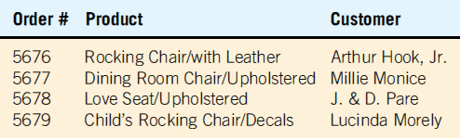
Simple Sequence Codes
A number that is assigned to something if it needs to be numbered
No relation to the data itself
Using a simple sequence code to indicate the sequence in which orders enter a custom furniture shop (Figure 15.1)
Kendall & Kendall Copyright © 2014 Pearson Education, Inc. Publishing as Prentice Hall
Notes:
Sequence codes should be used when the order of processing requires knowledge of the sequence in which items enter the system or the order in which events unfold.

Slide 9
Simple Sequence Codes (Advantages)
Eliminates the possibility of assigning the same number
It gives users an approximation of when the order was received
Kendall & Kendall Copyright © 2014 Pearson Education, Inc. Publishing as Prentice Hall

Slide 10
Simple Sequence Codes (Disadvantages)
When you do not wish to have someone read the code to figure out how many numbers have been assigned
When a more complex code is desirable to avoid a costly mistake
Kendall & Kendall Copyright © 2014 Pearson Education, Inc. Publishing as Prentice Hall

Slide 11
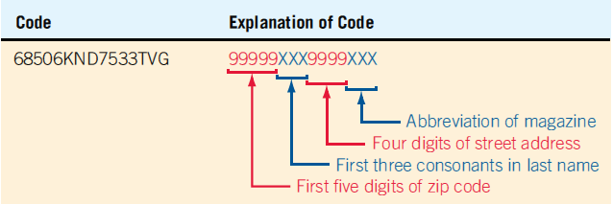
Alphabetic Derivation Codes
A commonly used approach in identifying an account number
Identifying the account of a magazine subscriber with an alphabetic derivation code (Figure 15.2)
Kendall & Kendall Copyright © 2014 Pearson Education, Inc. Publishing as Prentice Hall
Notes:
First five digits come from the first five digits of the subscribers zip code.
Next three are the first three consonants in the subscribers name.
Next four numbers are the street address.
Last three make up the code for the magazine.

Slide 12
Alphabetic Derivation Codes (Disadvantages)
When the alphabetic portion is small or when the name contains fewer consonants than the code requires
  Names like ROE—become RXX
Some of the data may change
Kendall & Kendall Copyright © 2014 Pearson Education, Inc. Publishing as Prentice Hall
Notes:
When the alphabetic portion is small—the name Po.
When the name contains fewer consonants than the code requires—the name Roe has only one consonant and would have to be derived as RXX, or derived using some other scheme.
Some of the data may change—changing name or address results in the key field being changed.

Slide 13
Classification Information
Affords the ability to distinguish between classes of items
Must be mutually exclusive
Classification codes
Block sequence codes
Kendall & Kendall Copyright © 2014 Pearson Education, Inc. Publishing as Prentice Hall
Notes:
Classifications are necessary for many purposes, such as reflecting what parts of a medical insurance plan and employee carries, or showing which student has completed the core requirements of his or her coursework.
Must be mutually exclusive—data are unclear and not as readily interpretable when coding classes are not mutually exclusive.
Classification codes.

Slide 14
Classification Codes
Used to distinguish one group of data with special characteristics from another
Can consist of either a single letter or a number
A shorthand way of describing a person, place, thing, or event
Listed in manuals or posted so that users can locate them easily
Kendall & Kendall Copyright © 2014 Pearson Education, Inc. Publishing as Prentice Hall

Slide 15
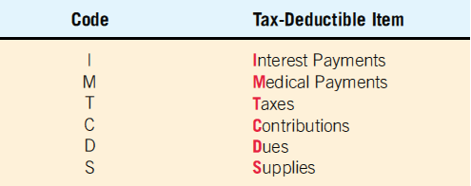
Classification Codes
Use a single letter for a code
Grouping tax-deductible items through the use of a one-letter classification code (Figure 15.3)
Kendall & Kendall Copyright © 2014 Pearson Education, Inc. Publishing as Prentice Hall

Slide 16
Block Sequence Codes
An extension of the sequence code
Data are grouped according to common characteristics
Simplicity of assigning the next available number (within the block) to the next item needing identification
Kendall & Kendall Copyright © 2014 Pearson Education, Inc. Publishing as Prentice Hall

Slide 17
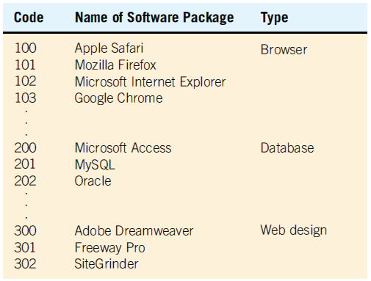
Using a Block Sequence Code to Group Similar Software Packages (Figure 15.5)
Kendall & Kendall Copyright © 2014 Pearson Education, Inc. Publishing as Prentice Hall

Slide 18
Concealing Information
Codes may be used to conceal or disguise information
Cipher Codes
Kendall & Kendall Copyright © 2014 Pearson Education, Inc. Publishing as Prentice Hall
Notes:
Cipher Codes—the direct substitution of one letter for another, one number for another, or one letter for a number.

Slide 19
Cipher Codes
The direct substitution of one letter for another, one number for another, or one letter for a number
Kendall & Kendall Copyright © 2014 Pearson Education, Inc. Publishing as Prentice Hall

Slide 20
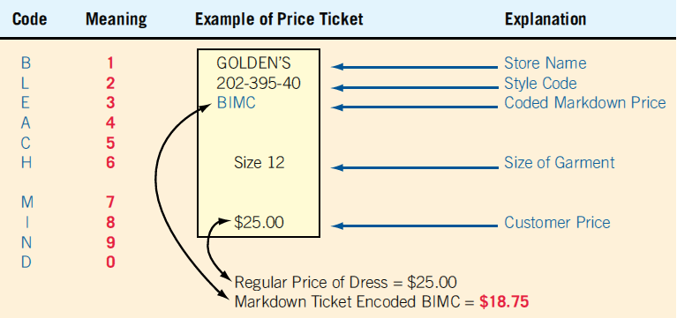
Encoding Markdown Prices with a Cipher Code Is a Way of Concealing Price Information from Customers
(Figure 15.6)
Kendall & Kendall Copyright © 2014 Pearson Education, Inc. Publishing as Prentice Hall

Slide 21
Revealing Information
Sometimes it is desirable to reveal information to specific users through a code
Makes the data entry more meaningful for humans
Significant-digit subset codes
Mnemonic codes
Unicode
Kendall & Kendall Copyright © 2014 Pearson Education, Inc. Publishing as Prentice Hall

Slide 22
Significant-Digit Subset Codes
Used to help describe a product by virtue of its membership in many subgroups
Possible to locate items that belong to a certain group or class
Inquiries may be performed on a portion of the code
Useful for a marketing product
Kendall & Kendall Copyright © 2014 Pearson Education, Inc. Publishing as Prentice Hall
Notes:
Used to help describe a product by virtue of its membership in many subgroups
An numeric item description may consist of:
digits representing the department
digits representing the product
digits representing the color
digits representing the size
Useful for a marketing product—when a customer purchases a certain type of book, a website might recommend other titles that have the same author, or similar content or style.

Slide 23
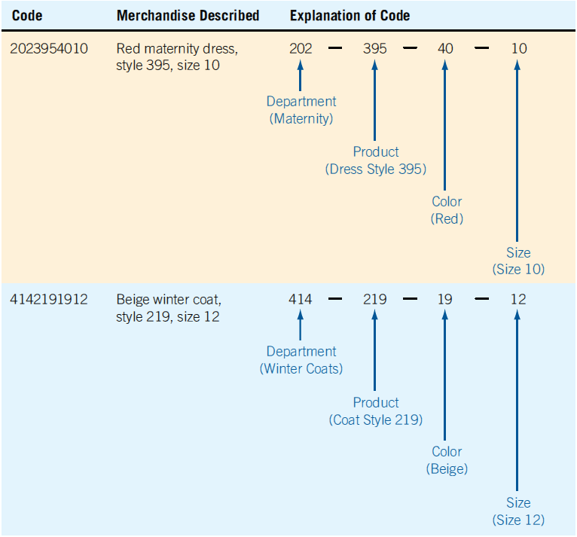
Using a Significant-Digit Subset Code Helps Employees Locate Items Belonging to a Particular Department
(Figure 15.7)
Kendall & Kendall Copyright © 2014 Pearson Education, Inc. Publishing as Prentice Hall

Slide 24
Mnemonic Codes
A mnemonic (pronounced nî-môn'-ïk) is a human memory aid
Any code that helps the data-entry person remember how to enter the data or the user remember how to use the information is a mnemonic
Using a combination of letters and symbols affords a clear way to code a product so that the code is easily seen and understood
Kendall & Kendall Copyright © 2014 Pearson Education, Inc. Publishing as Prentice Hall

Slide 25
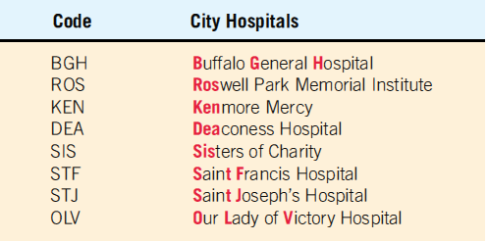
Mnemonic Codes Function as Memory Aids by Using a Meaningful Combination of Letters and Numbers (Figure 15.8)
Kendall & Kendall Copyright © 2014 Pearson Education, Inc. Publishing as Prentice Hall

Slide 26
Unicode
Includes all standard language symbols
Has room for 65,535 characters
The full set of Unicode characters are grouped by language and may be found at www.unicode.org
Kendall & Kendall Copyright © 2014 Pearson Education, Inc. Publishing as Prentice Hall
Notes:
Glyph symbols are represented using an “&#xnnnn;” notation, in which nnnn represents a specific letter or symbol, and x means that hexadecimal notation, or base 16 numbering, is used to represent the Unicode characters.

Slide 27
Requesting Appropriate Action
Instruct either the computer or the decision maker about what action to take
Function codes
Kendall & Kendall Copyright © 2014 Pearson Education, Inc. Publishing as Prentice Hall
Notes:
Generally, take the form of either sequence or mnemonic codes.

Slide 28
Function Codes
Short numeric or alphanumeric codes used to spell out precisely what activities are to be accomplished
Kendall & Kendall Copyright © 2014 Pearson Education, Inc. Publishing as Prentice Hall
Notes:
The functions that the analyst or programmer desires the computer to perform with data are captured in function codes.

Slide 29
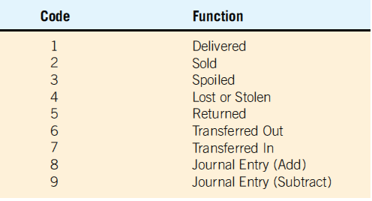
Function Codes Compactly Capture Functions that the Computer Must Perform (Figure 15.9)
Kendall & Kendall Copyright © 2014 Pearson Education, Inc. Publishing as Prentice Hall

Slide 30
General Guidelines for Coding
Be concise
Keep the codes stable
Ensure that codes are unique
Allow codes to be sortable
Avoid confusing codes
Keep the codes uniform
Allow for modification of codes
Make codes meaningful
Kendall & Kendall Copyright © 2014 Pearson Education, Inc. Publishing as Prentice Hall

Slide 31
Be Concise
Overly long codes mean more keystrokes and consequently more errors
Long codes also mean that storing the information in a database will require more memory
Short codes are easier for people to remember and easier to enter
If codes must be long, they should be broken up into subcodes
Kendall & Kendall Copyright © 2014 Pearson Education, Inc. Publishing as Prentice Hall
Notes:
Sometimes codes are made longer than necessary for a reason. Consider credit card numbers.

Slide 32
Keep the Codes Stable
Stability means that the identification code for a customer should not change each time new data are received
Don’t change the codes in a mnemonic system
Kendall & Kendall Copyright © 2014 Pearson Education, Inc. Publishing as Prentice Hall
Notes:
Don’t change the codes in a mnemonic system—makes it extremely difficult for data entry personnel to adapt.

Slide 33
Ensure that Codes Are Unique
For codes to work, they must be unique
Do not assign the same code number or name to the same items
Kendall & Kendall Copyright © 2014 Pearson Education, Inc. Publishing as Prentice Hall

Slide 34
Allow Codes to Be Sortable
Make sure that users can do what you intend to do with the codes you create
Numerical codes are much easier to sort than alphanumeric data
Kendall & Kendall Copyright © 2014 Pearson Education, Inc. Publishing as Prentice Hall
Notes:
If you are going to manipulate the data usefully, the codes must be sortable.

Slide 35
Avoid Confusing Codes
Avoid using coding characters that look or sound alike
Kendall & Kendall Copyright © 2014 Pearson Education, Inc. Publishing as Prentice Hall
Notes:
O (the letter oh) and 0 (the number zero).
Letter I and the number 1.
Letter Z and the number 2.
Codes such as B1C and 280Z are confusing
Canadian Postal Code.
The code format is X9X 9X9.

Slide 36
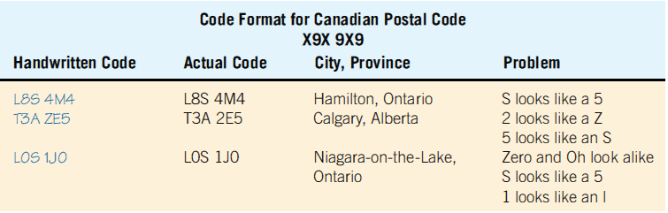
Combining Look-Alike Characters in Codes Can Result in Errors (Figure 15.12)
Kendall & Kendall Copyright © 2014 Pearson Education, Inc. Publishing as Prentice Hall

Slide 37
Keep the Codes Uniform
Need to follow readily perceived forms
Keep codes uniform among as well as within programs
Kendall & Kendall Copyright © 2014 Pearson Education, Inc. Publishing as Prentice Hall
Notes:
In order to be effective and efficient for humans, codes need to follow readily perceived forms most of the time.
Keep codes uniform as well as within programs:
avoid using the codes MMDDYY in one application
YYDDMM in a second
MMDDCCYY in a third; CC—century

Slide 38
Allow for Modification of Codes
The system will evolve over time
The coding system should be able to encompass change
Kendall & Kendall Copyright © 2014 Pearson Education, Inc. Publishing as Prentice Hall
Notes:
The analyst needs to be able to forecast the predictable changes that business users will desire and anticipate a wide range of future needs when designing codes.

Slide 39
Make Codes Meaningful
Effective codes contain information
Should make sense to people using them
Easier to understand, work with, and recall
Kendall & Kendall Copyright © 2014 Pearson Education, Inc. Publishing as Prentice Hall
Notes:
The job of data entry becomes more interesting when working with meaningful codes instead of just entering a series of meaningless numbers.

Slide 40
Using Codes
Validation programs
Report and inquiry programs
GUI programs
Kendall & Kendall Copyright © 2014 Pearson Education, Inc. Publishing as Prentice Hall
Notes:
Validation programs—to ensure that only valid codes have been entered.
Report and inquiry programs—to display code meanings. Reports and displays should not print the actual codes.
GUI programs—to create drop-down lists.

Slide 41
Effective and Efficient Data Capture
Deciding what to capture
Letting the computer do the rest
Avoiding bottlenecks and extra steps
Starting with a good form
Choosing a data-entry method
Kendall & Kendall Copyright © 2014 Pearson Education, Inc. Publishing as Prentice Hall
Notes:
To ensure the quality of data users enter into the system, it is important to capture data effectively.

Slide 42
Deciding What to Capture
Data that change or vary with every transaction
Data that concisely differentiate the particular item being processed from all other items
Kendall & Kendall Copyright © 2014 Pearson Education, Inc. Publishing as Prentice Hall
Notes:
The decision about what to capture precedes user interaction with the system. “Garbage in, garbage out”
Data that change or vary with every transaction:
example: the quantity of supplies purchased each time an advertising firm places an order with the office supply wholesaler.
Data that concisely differentiate the particular item being processed from all other items:
example: the inclusion on a patient record of the patient’s Social Security number and the first three letters of his or her last name.

Slide 43
Letting the Computer Do the Rest
Recording the time of the transaction
Calculating new values from input
Storing and retrieving data on demand
Kendall & Kendall Copyright © 2014 Pearson Education, Inc. Publishing as Prentice Hall
Notes:
By employing the best features of computers, efficient data capture design avoids needless data entry, which in turn alleviates much human error and boredom and permits people to focus on higher-level or creative tasks.

Slide 44
Avoiding Bottlenecks and Extra Steps
Data are poured rapidly into the wide mouth of the system only to be slowed in its “neck” because of an artificially created instance of insufficient processing for the volume or detail of the data being entered
The fewer steps involved in inputting data, the fewer chances there are for the introduction of errors
Kendall & Kendall Copyright © 2014 Pearson Education, Inc. Publishing as Prentice Hall
Notes:
One way a bottle neck can be avoided is by ensuring that there is enough capacity to handle the data that are being entered.
Use of an online, real-time system that captures customer data without necessitating the completion of a form is an excellent example of saving steps in data entry.

Slide 45
Starting with a Good Form
With effective forms, it is not necessary to reenter information that the computer has already stored, or data such as time or date of entry that the computer can determine automatically
Kendall & Kendall Copyright © 2014 Pearson Education, Inc. Publishing as Prentice Hall

Slide 46
Choosing a Data-Entry Method
Keyboards
Bar codes
QR (Quick Response) codes
Microsoft tags
RFID
NFC (Near Field Communication)
Optical character recognition
Magnetic ink character recognition (MICR)
Mark-sense forms
Kendall & Kendall Copyright © 2014 Pearson Education, Inc. Publishing as Prentice Hall
Notes:
Choosing a data-entry method:
need for speed
accuracy
user training
cost
methods currently in use

Slide 47
Keyboards
Special function keys to open programs
Keys used to scroll and explore the Web
Keys that can be programmed with macros to reduce the number of keystrokes required
Ergonomic keyboards and infrared or Bluetooth-enabled keyboards
Kendall & Kendall Copyright © 2014 Pearson Education, Inc. Publishing as Prentice Hall

Slide 48
Bar Codes
Affords a high degree of accuracy for data entry
Saves labor costs
Allows the automatic capturing of data
Tracking of credit card purchases
Kendall & Kendall Copyright © 2014 Pearson Education, Inc. Publishing as Prentice Hall
Notes:
Saves labor costs—each item does not have to be individually price-marked.
Allows the automatic capturing of data—can be used for reordering, more accurate inventory tracking, forecasting.
Tracking of credit card purchases—for building a consumer profile that can be used to refine marketing to that individual or type of consumer.

Slide 49
2D Bar Codes
Are matrix bar code squares are two-dimensional (2D) bar codes
Are optical, machine-readable codes
Take up much less space than the older linear bar codes
Are cheaper than RFID tags
Can appear in print
Kendall & Kendall Copyright © 2014 Pearson Education, Inc. Publishing as Prentice Hall

Slide 50
QR (Quick Response) Codes
A QR (Quick Response) code is easily identifiable
  Uses a position marker
  Three nested squares that appear in three of its corners
QR codes are completely free
2D code readers are likely to be able to read a QR code
Kendall & Kendall Copyright © 2014 Pearson Education, Inc. Publishing as Prentice Hall

Slide 51
Microsoft Tags
Microsoft tags use four colors
They work if they are printed monochromatically
Creating, publishing, and using Microsoft Tags is free
The code is a Web link
When the code is read and the reader app reaches the server, it is redirected to the intended website
This allows for collecting and storing data that can be subjected to analytics
A drawback to this redirection is that there is only one reader app—the official one from Microsoft
Kendall & Kendall Copyright © 2014 Pearson Education, Inc. Publishing as Prentice Hall

Slide 52
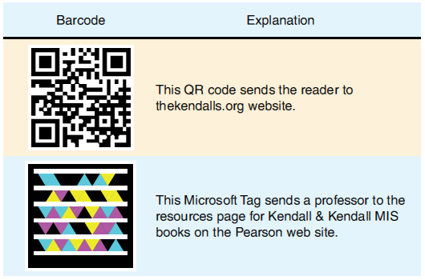
Two Popular 2D Bar Codes
(Figure 15.15)
Kendall & Kendall Copyright © 2014 Pearson Education, Inc. Publishing as Prentice Hall

Slide 53
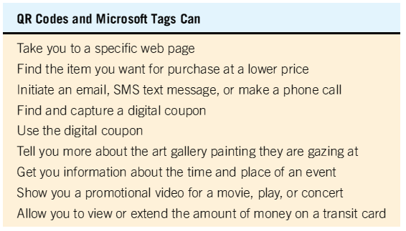
QR Codes and Microsoft Tags
(Figure 15.16)
Kendall & Kendall Copyright © 2014 Pearson Education, Inc. Publishing as Prentice Hall

Slide 54
RFID
Allows the automatic collection of data using RFID tags that contain a chip and an antenna
Passive RFID tags
Active RFID tags
Privacy is a concern
Kendall & Kendall Copyright © 2014 Pearson Education, Inc. Publishing as Prentice Hall
Notes:
Passive RFID tags—have no internal power source—inexpensive.
Active RFID tags—have their own power source—more reliable.
Privacy is a concern—it could be possible to identify an individual if a tagged item is paid for by a credit card.

Slide 55
NFC (Near Field Communication)
Another approach is near field communication
NFC allows two-way communication
Is used in contactless payment systems at checkout counters
Customers use a smartphone to touch or come close to the point-of-sale device
NFC can also be used:
  Payment on transportation systems
  Exchange information
  Receive custom coupons
  Exchange business cards
Considered secure because of short range of communication
Kendall & Kendall Copyright © 2014 Pearson Education, Inc. Publishing as Prentice Hall

Slide 56
Optical Character Recognition
Increased speed
Eliminates many of the time-consuming and error-fraught steps of other input devices
Decentralizes responsibility for quality data directly to the unit that is generating it
The transformation of faxes into documents that can be edited
Kendall & Kendall Copyright © 2014 Pearson Education, Inc. Publishing as Prentice Hall
Notes:
Increased speed—can speed data input from 60 to 90 percent over some keying methods.
Eliminates many of the time-consuming and error-fraught steps of other input devices—OCR demands few employee skills and less training, resulting in fewer errors and less time spend by employees in redundant efforts.

Slide 57
Magnetic Ink Character Recognition
A reliable and high-speed method that is not susceptible to accepting stray marks
If it is required on all withdrawal checks, it serves as a security measure against bad checks
Data entry personnel can see the numbers making up the code if it is necessary to verify it
Kendall & Kendall Copyright © 2014 Pearson Education, Inc. Publishing as Prentice Hall

Slide 58
Mark-Sense Forms
Little training of entry personnel is necessary
A high volume of forms can be processed quickly
Stray marks on form can be entered as incorrect data
Choices are limited to the answers provided
Difficulty in capturing alphanumeric data
Easy to get confused and put a mark in an incorrect position
Kendall & Kendall Copyright © 2014 Pearson Education, Inc. Publishing as Prentice Hall
Notes:
Mark-sense forms allow data entry through the use of a scanner that senses where marks have been made on special forms.

Slide 59
Ensuring Data Quality through Input Validation
The critical importance of catching errors during input, prior to processing and storage cannot be overemphasized
Potential problems
  Validating input transactions
  Validating input data
Kendall & Kendall Copyright © 2014 Pearson Education, Inc. Publishing as Prentice Hall

Slide 60
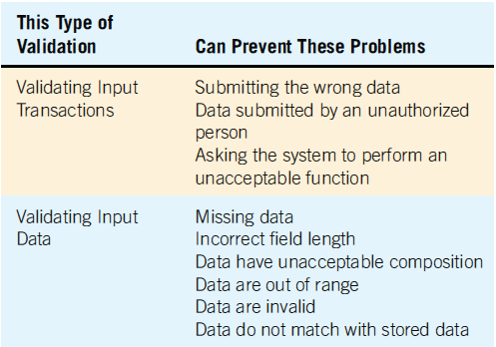
Validating Input Is Important to Ensure That Most Potential Problems with Data Are Eliminated Early (Figure 15.18)
Kendall & Kendall Copyright © 2014 Pearson Education, Inc. Publishing as Prentice Hall

Slide 61
Validating Input Transactions
Submitting the wrong data
Submitting of data by an unauthorized person
Asking the system to perform an unacceptable function
Kendall & Kendall Copyright © 2014 Pearson Education, Inc. Publishing as Prentice Hall
Notes:
Submitting the wrong data—attempt to input a patient’s Social Security number into a hospital’s payroll system.
Submitting of data by an unauthorized person—only the supervising pharmacist should be able to enter inventory totals for controlled substances in the pharmacy.
Asking the system to perform an unacceptable function—it would be logical for a human resources manager to update the existing record of a current employee, but it would be invalid to ask the system to create a new file rather than merely update an existing one.

Slide 62
Validating Input Data
Test for missing data
Test for correct field length
Test for class or composition
Test for range or reasonableness
Test for invalid values
Cross-reference checks
Test for comparison with stored data
Set up self-validating codes (check digit)
Kendall & Kendall Copyright © 2014 Pearson Education, Inc. Publishing as Prentice Hall
Notes:
Test for missing data—a Social Security file would be invalid if it did not include the payee’s Social Security number.
Test for correct field length—if the Omaha, NE, weather station reports into the national weather service computer but mistakenly provides a two-letter city code (OM) instead of the national three-letter code (OMA), the input data might be deemed invalid, and hence would not be processed.
Test for class or composition—a credit card account number for American Express should not include any letters.
Test for range or reasonableness—if a user was trying to verify a proposed shipment date, the range test would neither permit a shipping date on the 32nd day of October nor accept shipment in the 13th month.
Test for invalid values—a brokerage firm divides accounts into three classes only. If data are assigned to any other class through an error, the values are invalid.
Cross-reference checks—the price for which an item is sold should be greater than the cost paid for the item.
Test for comparison with stored data—a newly entered part number can be compared with the complete parts inventory to ensure that the number exists and is being entered correctly.
Setting up self-validating codes (check digit)—the clerk types in 54411 instead of 53411. Only the digit in the thousands place is incorrect, but this error may result in the wrong part being shipped.

Slide 63
The Process of Validation
Check first for missing data
Check the syntax
Check the semantics
GUI screens can help to reduce the number of human input errors when they incorporate radio buttons, check boxes, and drop-down lists
Kendall & Kendall Copyright © 2014 Pearson Education, Inc. Publishing as Prentice Hall
Notes:
Check the syntax—the length, class, and composition.
Check the semantics—the meaning of the data. A range, reasonable, or value test followed by a check digit test.

Slide 64
The Process of Validation (continued)
Regular expressions
Validating XML documents
  DTD
  Schema
Kendall & Kendall Copyright © 2014 Pearson Education, Inc. Publishing as Prentice Hall
Notes:
Pattern validation:
use a pattern for validation
symbols represent the type of data
DTD will check to see if the format of the document is valid, but a schema will check the type of data, such as short or long integer, a decimal number, or date. A schema will also check a range of values, the number of digits to the left and right of a decimal point, and values of codes.

Slide 65
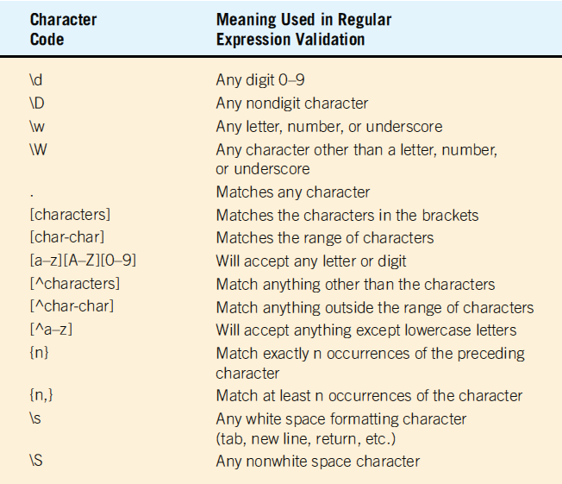
These Characters Are Used in Regular Expression (Pattern) Validation (Figure 15.19)
Kendall & Kendall Copyright © 2014 Pearson Education, Inc. Publishing as Prentice Hall

Slide 66
Accuracy Advantages in Ecommerce Environments
Customers generally key or enter data themselves
Data entered by customers are stored for later use
Data entered at the point of sale are reused throughout the entire order fulfillment process
Information is used as feedback to customers
Kendall & Kendall Copyright © 2014 Pearson Education, Inc. Publishing as Prentice Hall
Notes:
Customers generally key or enter data themselves—customers know their own information better than anyone else.
Data entered by customers are stored for later use—autocomplete and cookies.
Data entered at the point of sale are reused throughout the entire order fulfillment process—allows better supply chain management, including checking product and resource availability electronically, and automating planning, scheduling, and forecasting.
Information is used as feedback to customers—accuracy is improved by better feedback.

Slide 67
Cookies
Store information to enable faster and more accurate transactions
Use a small file (the cookie) on the user’s computer
Once information is stored in a cookie, a website can suggest matches for credit card and password information
The information is encrypted so that other websites cannot read the cookie
Personal information can only be accessed by the company that placed the cookie on the user’s computer
Kendall & Kendall Copyright © 2014 Pearson Education, Inc. Publishing as Prentice Hall

Slide 68
Summary
Quality of data
  Effective coding
  Effective and efficient data capture
  Validation of data
Kendall & Kendall Copyright © 2014 Pearson Education, Inc. Publishing as Prentice Hall

Slide 69
Summary (continued)
Coding
  Sequence codes
  Alphabetic derivation codes
  Classification codes
  Block sequence codes
  Cipher codes
  Significant-digit subset codes
  Mnemonic codes
  Uniform character set
  Function codes
Kendall & Kendall Copyright © 2014 Pearson Education, Inc. Publishing as Prentice Hall

Slide 70
Summary (continued)
Input devices
  Keyboards
  Bar codes
  QR (Quick Response) codes
  Microsoft tags
  RFID
  NFC (Near Field Communication)
  Optical character recognition
  Magnetic ink character recognition (MICR)
  Mark-sense forms
Kendall & Kendall Copyright © 2014 Pearson Education, Inc. Publishing as Prentice Hall

Slide 71
Summary (continued)
Input validation
  Input transaction
  Input data
Ecommerce
Kendall & Kendall Copyright © 2014 Pearson Education, Inc. Publishing as Prentice Hall

Slide 72

Copyright © 2014 Pearson Education, Inc.
Publishing as Prentice Hall

